Slide 1
SUPPLY AND DEMAND GAP ANALYSIS FOR UBER
Chethan Kumar D K

Slide 2
Table of Contents
Aim
Introduction
Problem statement
Methodology
Analysis (Data sheets pertaining to it)
Insights
Recommendations
Conclusions
Notes:
Insert a map of your country.

Slide 3
Aim
The aim of this project is to conduct a supply and demand gap analysis for Uber, a ride-hailing company, in order to identify the gap between the demand for its services and the supply of drivers.
Notes:
Insert a picture of one of the geographic features of your country.

Slide 4
Introduction
Uber is a ride-hailing company that provides transportation services through its mobile app. It was founded in 2009 and has since expanded to more than 700 cities worldwide. Uber's business model relies on the availability of a large number of drivers to meet the demand for its services.
However, there have been instances where the demand has exceeded the supply of drivers, leading to longer wait times and higher prices for customers.
Notes:
Insert a picture illustrating a season in your country.

Slide 5
Problem Statement
The problem statement for this project is to identify the gap between the demand for Uber's services and the supply of drivers, and to provide recommendations for reducing the gap.
Notes:
Insert a picture of an animal and or plant found in your country.

Slide 6
Methodology
Data Importing
Data cleaning
Data visualization:
Data analysis
Notes:
Add key points in the history of your country to the timeline.

Slide 7
Visualization and Analysis
The dataset contains the following columns
Request ID - It is a unique ID generated when the customer makes a request for the cab.
Pickup Point – It is the point of pickup of the customer (airport or city).
Status – It is the status of the request whether the trip was completed or no cars available or cancelled.
Driver ID – It is the ID of the driver who got the request if cars were available.
Request Timestamp – It is the date and time of the request.
Drop timestamp – It is the date and time of the drop.
Notes:
Add key points in the history of your country to the timeline.

Slide 8
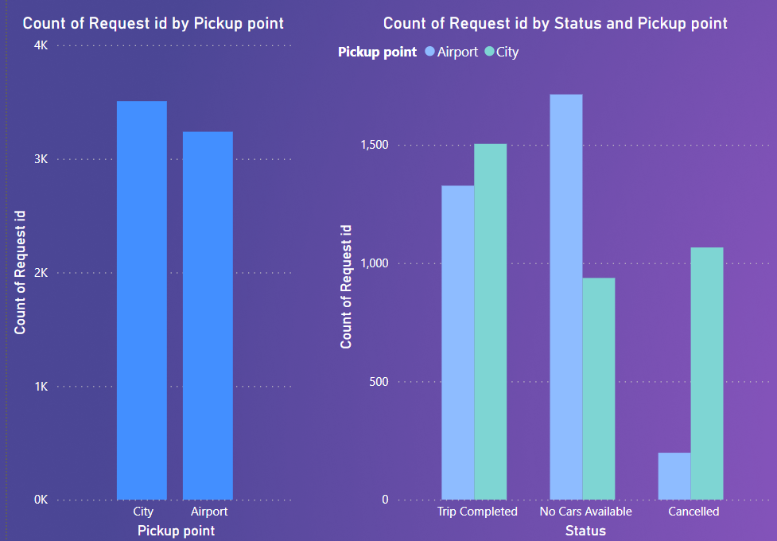
Visualization and Analysis
No. of requests made at the city is higher as compared to Airport.
No. of “No cars Available” is more at the Airport.
No. of “Cancelled Requests” is more at the city.
Notes:
Insert a picture illustrating a custom or tradition here.

Slide 9
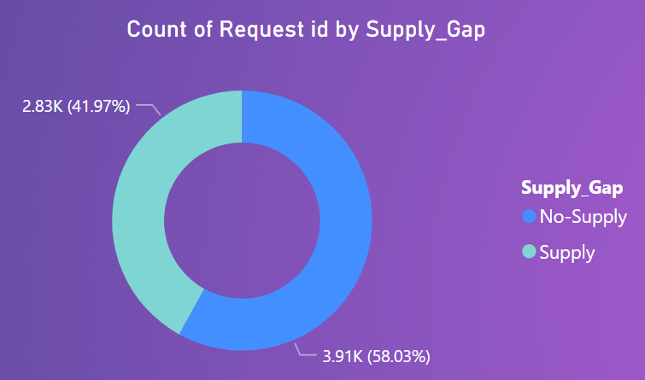
Visualization and Analysis
Out of 100 Requests UBER has a Capacity to accept only 42 Requests.
Notes:
Insert a picture illustrating a custom or tradition here.

Slide 10
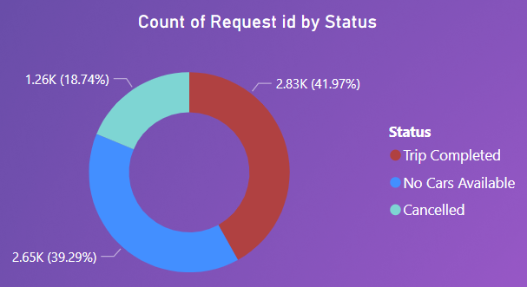
Visualization and Analysis
Out of 100 Requests, only 42 Complete the trip, 39 Do not find car and 18 Cancelled requests.
Notes:
Insert a picture illustrating a custom or tradition here.

Slide 11
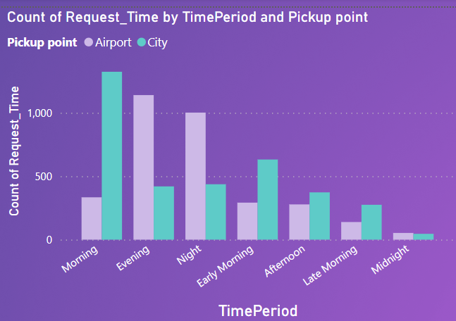
Visualization and Analysis
The Demand for Cars at the City is max. during the morning.
The Demand for Cars at the Airport is max. during the Evening and Night.
Notes:
Insert a picture illustrating a custom or tradition here.

Slide 12
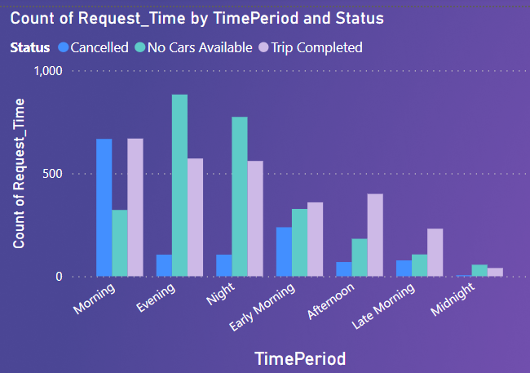
Visualization and Analysis
The probability of finding a Car is less during the Evening, Night.
Max. no. of trips are completed during Morning, Evening, Night.
The probability of cancelling Car request is high during the Morning.
Notes:
Insert a picture illustrating a custom or tradition here.

Slide 13
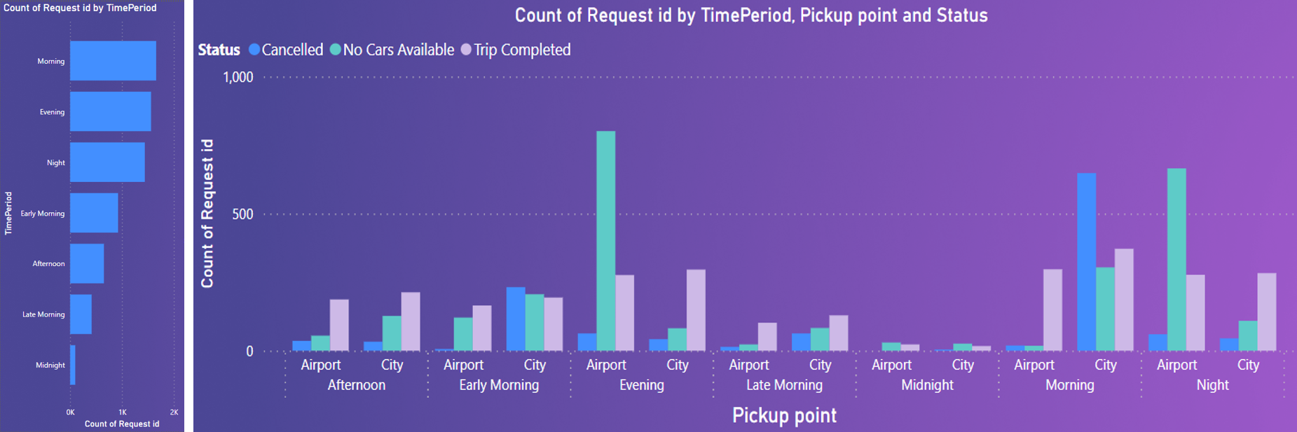
Visualization and Analysis
The Demand for Cars are more during Morning, Evening, Night.
The probability of finding a Car is less during the Evening, Night at the airport and Morning at the city.
The probability of cancelling Car request is high during the Morning at the city.
Notes:
Insert a picture illustrating a custom or tradition here.

Slide 14
Insights
There are 2 peaks (Morning and Evening) where there is a max. demand for cars.
During Morning where the demand for car is high at the city, there are maximum number of trip cancellations which lead to Gap in the Demand & Supply.
During Evening where the demand for car is high at the Airport, there are maximum number of “No Cars Available” which lead to Gap in the Demand & Supply.
Notes:
Insert a picture of the head leader of your country.

Slide 15
Recommendations
Increase the no. of cars so that the people find cars.
Uber should provide higher rewards Peak Morning and Evening so they don’t cancel.
Notes:
Insert a picture of the head leader of your country.

Slide 16
Conclusions
The demand during Morning and Afternoon from the Airport to City is low, a driver who completed a trip from City to Airport in the morning should wait a long time to get a ride back to the city, or he must come back without passengers.
Uber can provide some incentives to the drivers who complete the trip from city to airport in the morning part. This might result the driver to not cancel the request from city to airport trips.
Increase the No. of Drivers.
Notes:
Insert a picture of the head leader of your country.

Slide 17
Thank you
Notes:
Insert a picture of one of the points of interest for your country.

